Slide 1

Optimizing Your AWS Bill: Strategies for Reducing Costs and Maximizing ROI

Slide 2



Introductions
Trent Nielsen
Justin Wheeler
wheeleruniverse
Enterprise Architect @ PXG
Independent Cloud Consultant
AWS User Group Leader
Senior Software Developer @ Bravo LT
13x AWS Certified
AWS Community Builder
AWS User Group Leader

Slide 3
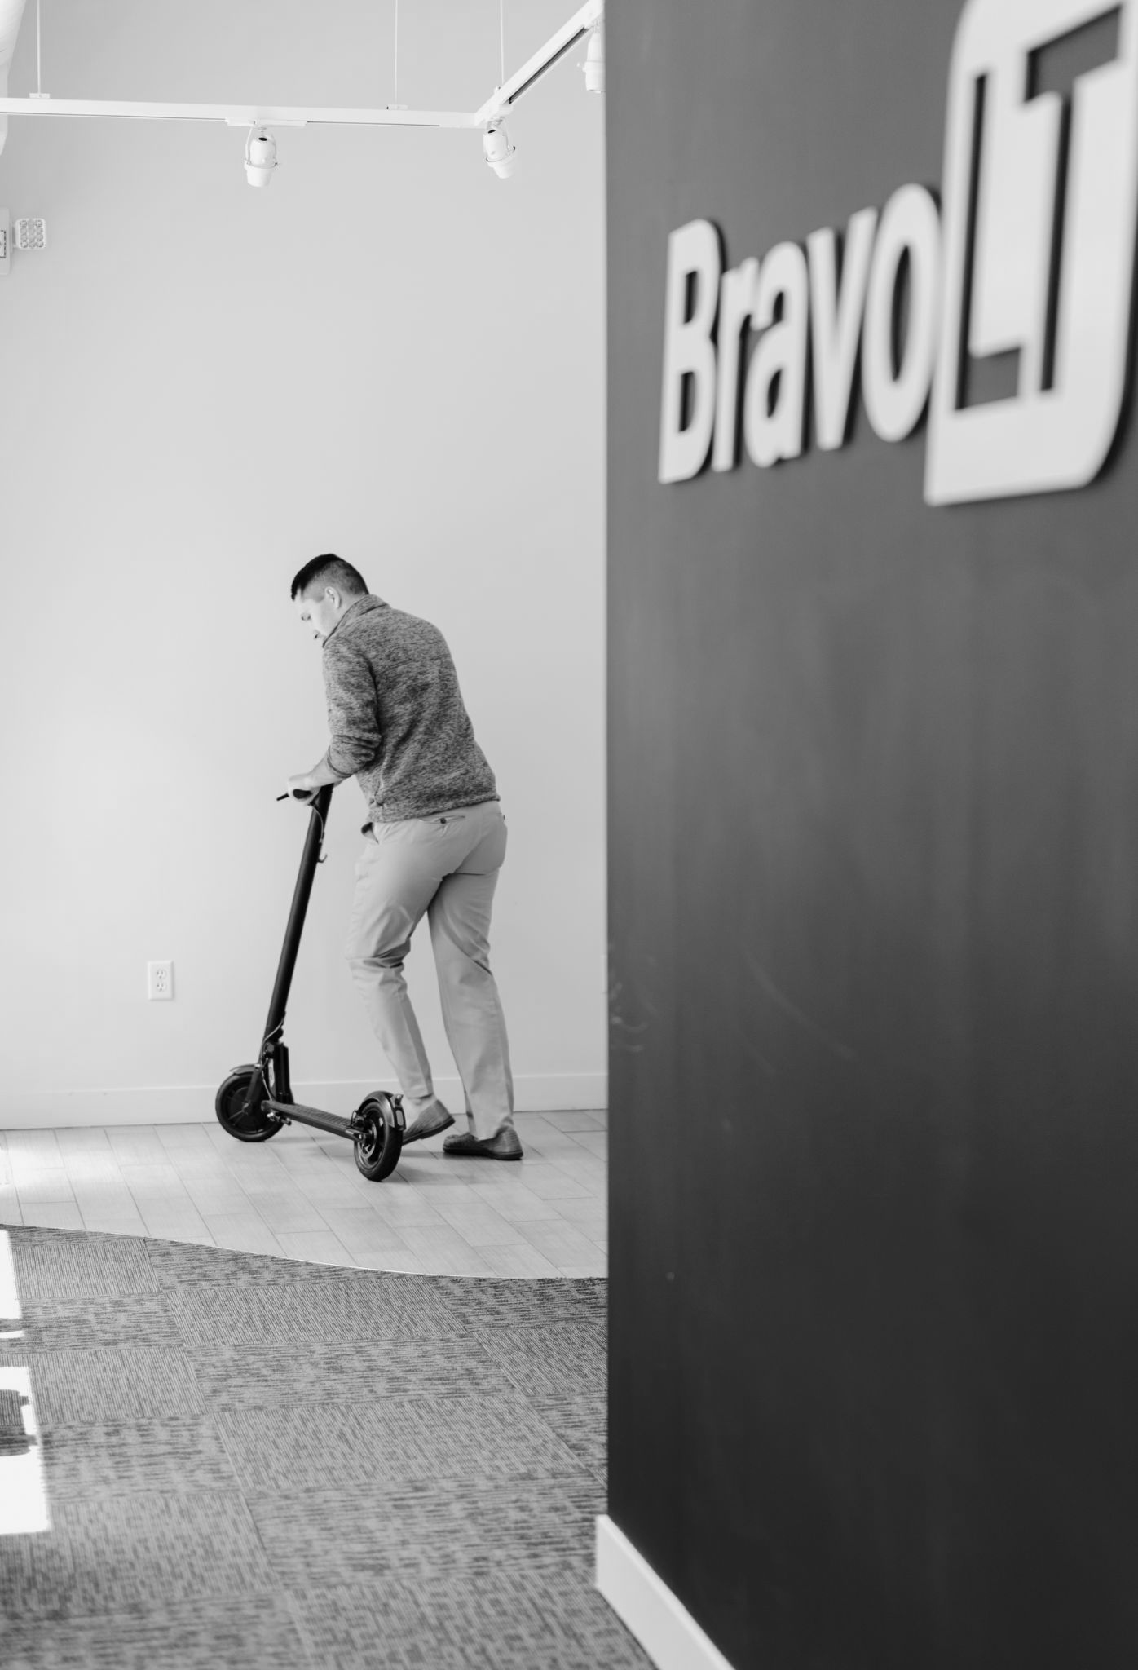

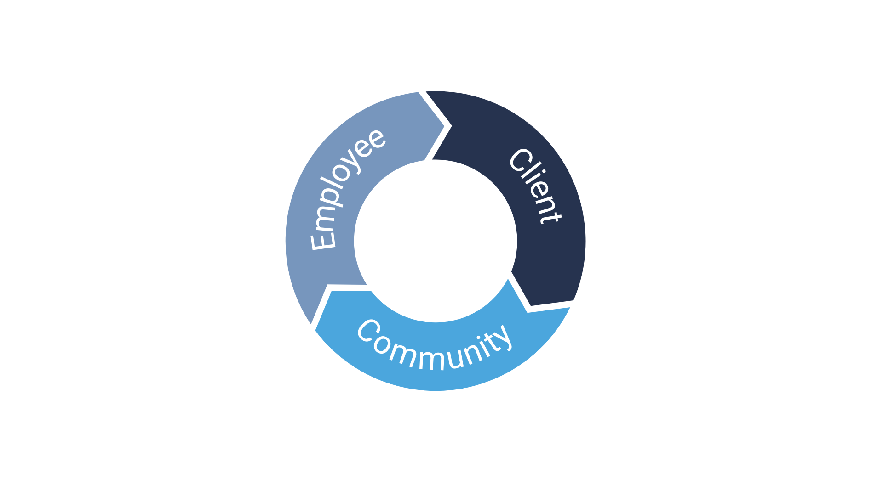
To empower our clients, team, and community to succeed through compassion, professionalism and the power of technology.

Slide 4



We listen to our clients to understand their challenges and deliver the correct talent solutions that mix industry expertise and cost effectiveness.
Our Locations
U.S. I Grand Rapids
MEX I Monterrey
POL I Warsaw

Slide 5
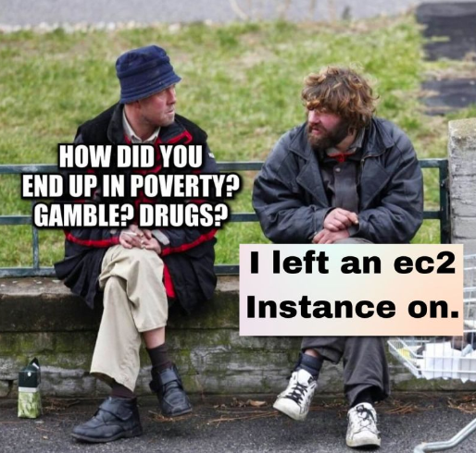

Slide 6
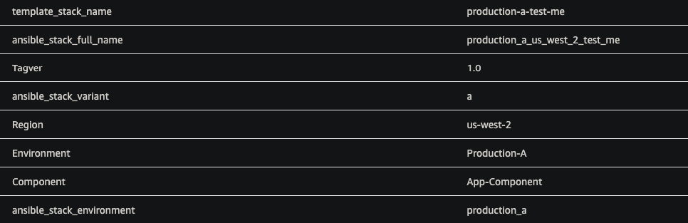
Cost Reporting Starts with Tags
Metadata Labels
Key: Value Pairs
Assigned to AWS Resources
Up to 50 User Tags Per Resource
Enables easier reporting on AWS usage

Slide 7

Think Concise
Region
Stack/Service
Component
Environment
Variant
Business Unit
Less is more

Slide 8
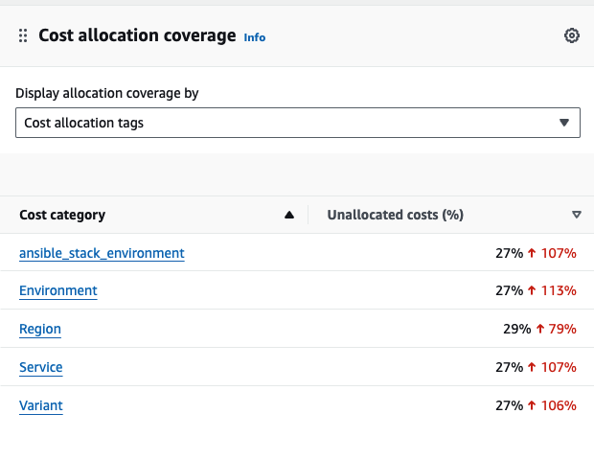
Cost Reporting Starts with Tags
Good coverage is required for accurate, effective cost reporting and monitoring.
Tags allow reporting on AWS usage

Slide 9
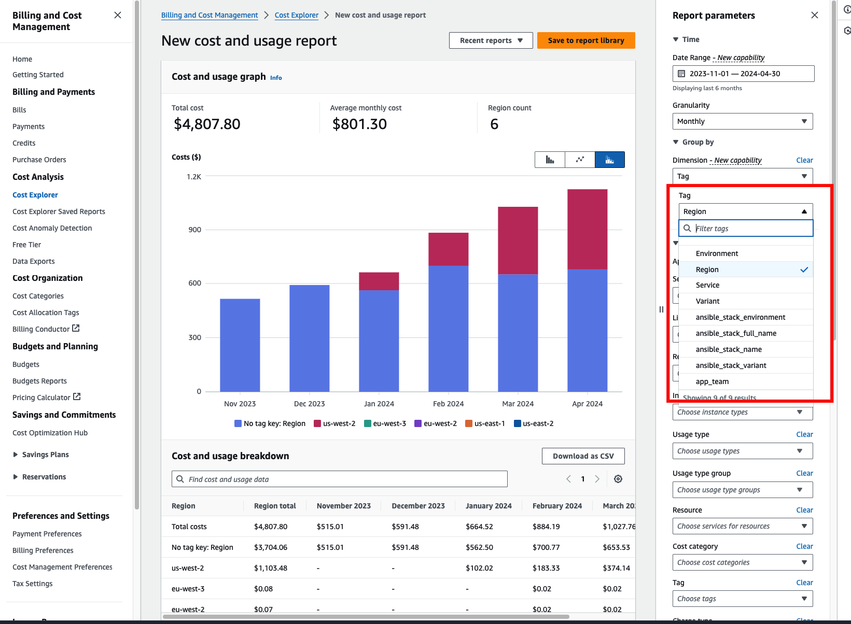
Review by Tag

Slide 11
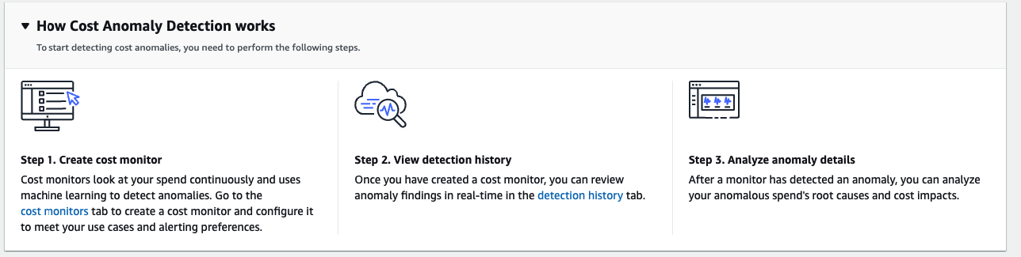
Anomaly Detection

Slide 12





Monitoring and Reporting
Cost Explorer
Reporting
Data Exports
Anomaly Monitors
Threshold Alerts

Slide 13

Compute Savings

Slide 14


Slide 15
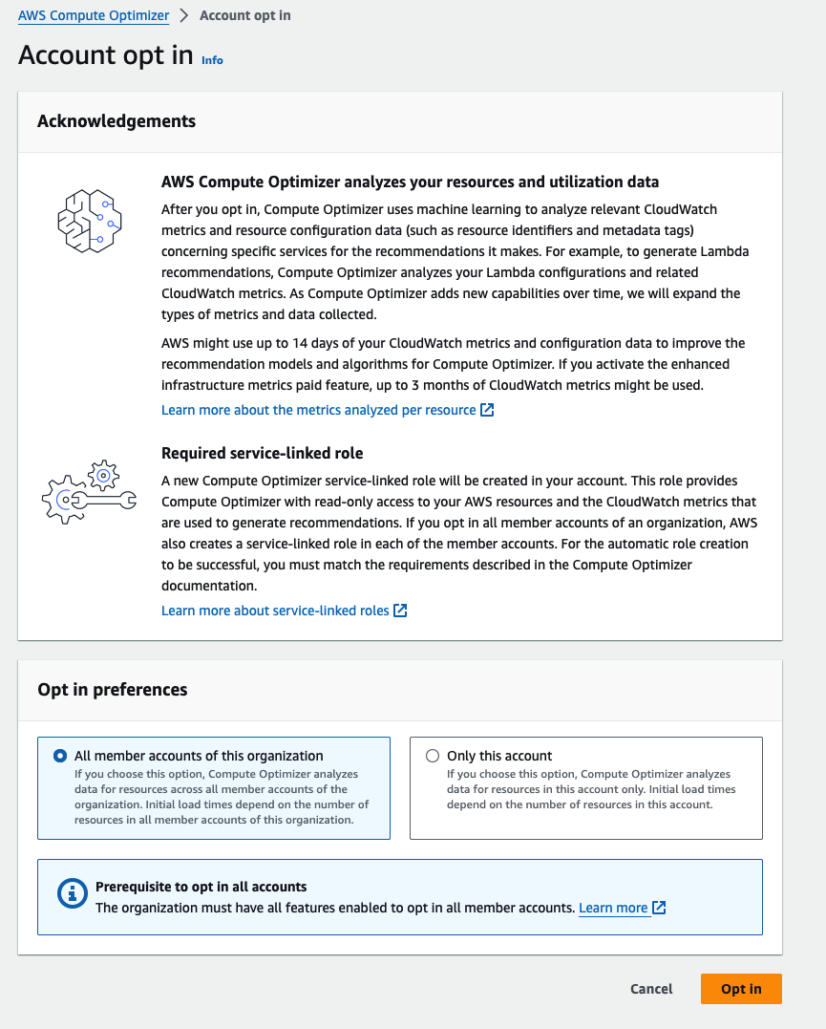
Compute Optimizer
Provides Right Sizing Recommendations
EC2
ECS
Lambda

Slide 16
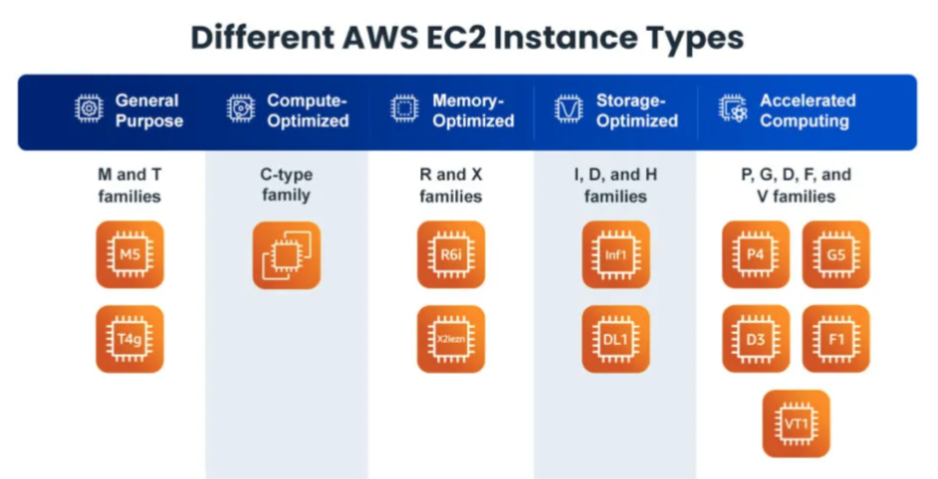

Slide 17
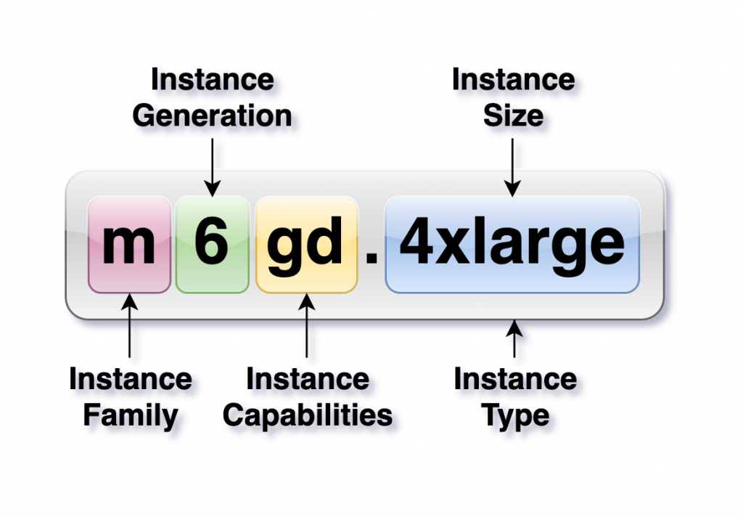
Instance Considerations
Generation
Family
Size
Purchasing Option

Slide 18
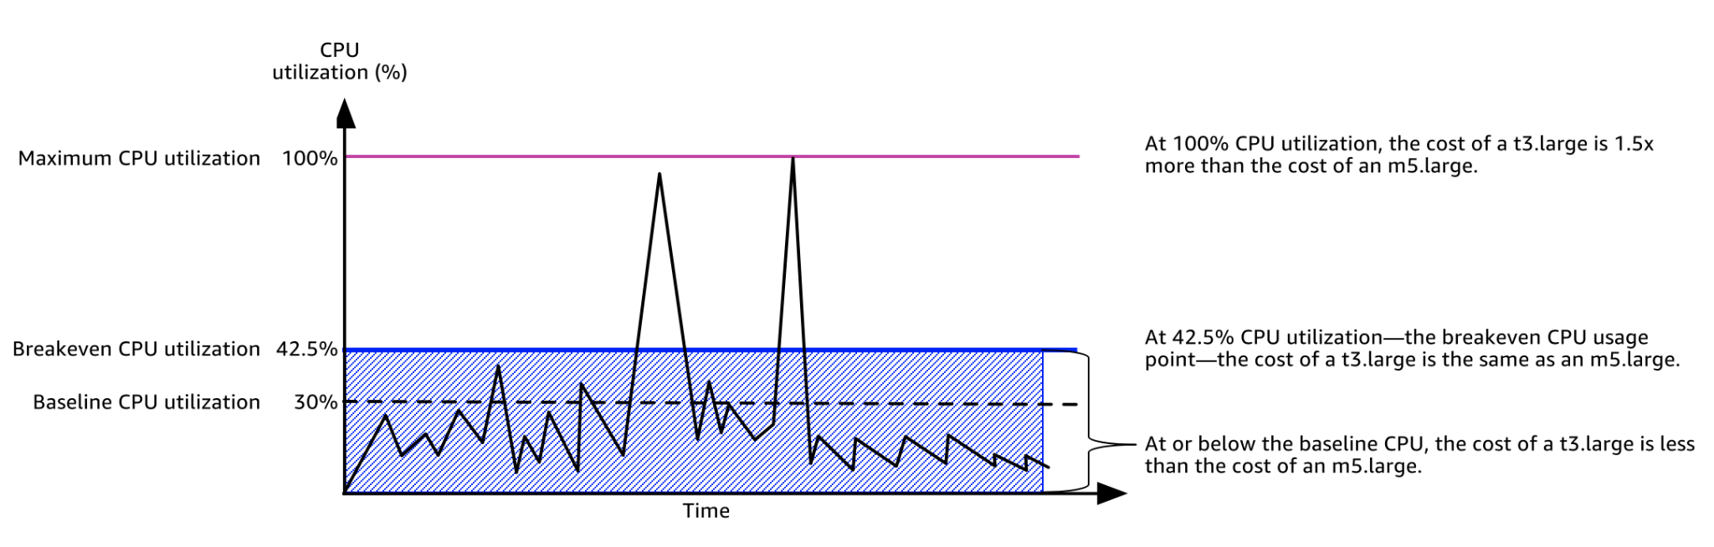
Unlimited Mode (t*) Considerations

Slide 19
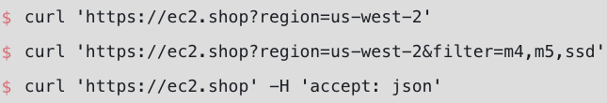
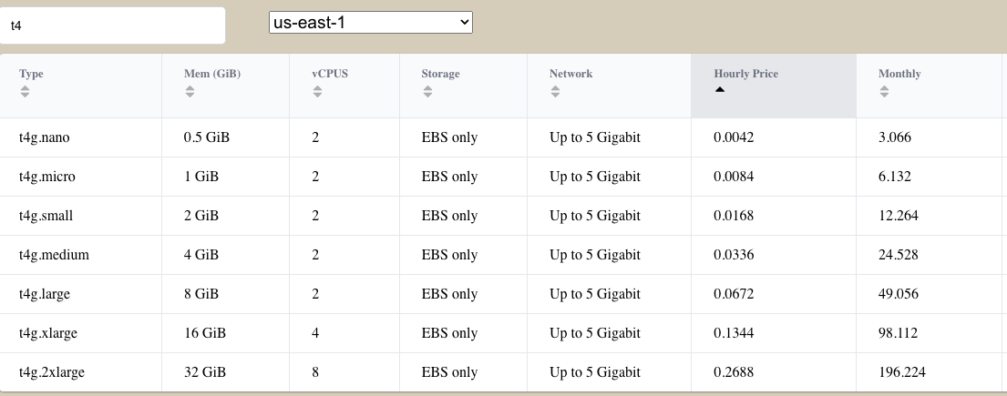
https://ec2.shop/

Slide 20
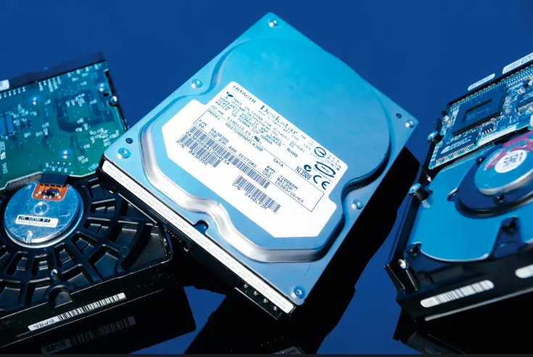
EBS Right Sizing
Evaluate storage requirements
Evaluate storage utilization
Evaluate storage types
Evaluate alternative store
Review backups

Slide 21
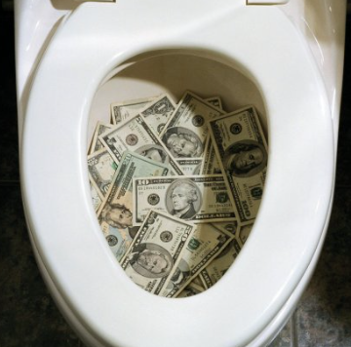
Downsizing Non Prod
Consider Burstable Types for Long-Lived Instances
Consider Spot Instances
Scale Auto Scaling Groups to 0
Don’t Pay 24x7
for 8x5 Requirements

Slide 22


Turn Off Non Prod
Long-Lived Instance Updates
Avoid Tombstones
Patch Vulnerabilities
Consider Other Teams
You can shut them off but….

Slide 23
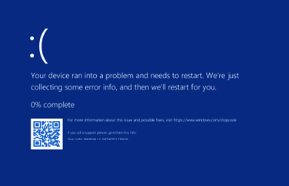

Stop Running Windows!
=
Instances are ~3x more than Linux

Slide 24
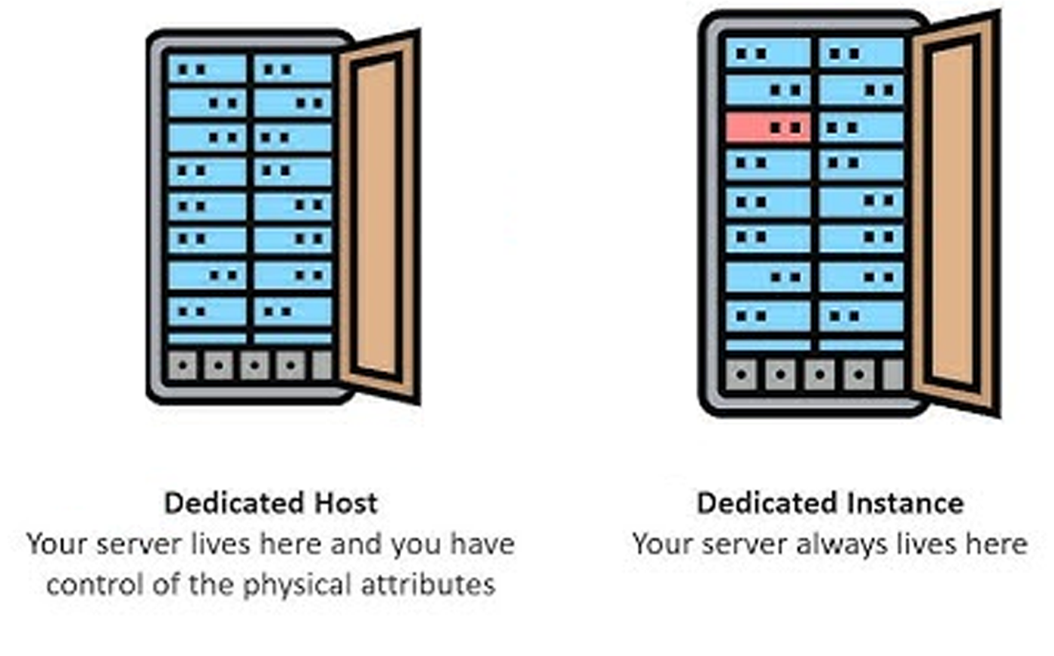
Dedicated Hosts and Instances
✓ Compliance
✓ Licensing
✓ Mac Instances
✓ Hardware Isolation

Slide 25

Try ARM Workloads
20 to 30% Cheaper

Slide 26




Stop Running EC2!
Up to 2x the Cost of Other Options
ECS
Lambda
EC2

Slide 27


Consider Lambda
Scheduled Jobs (Cron)
Bursty Workloads

Slide 28
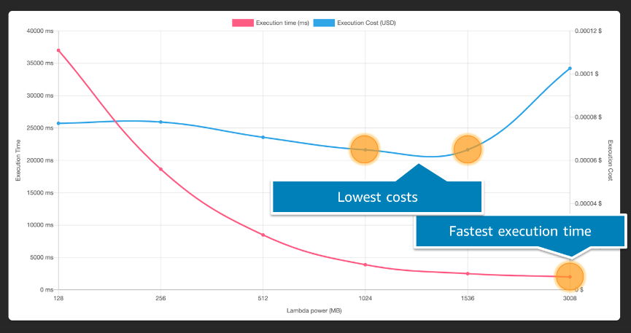

Optimize Lambda with Power Tuning
https://docs.aws.amazon.com/lambda/latest/operatorguide/profile-functions.html

Slide 29
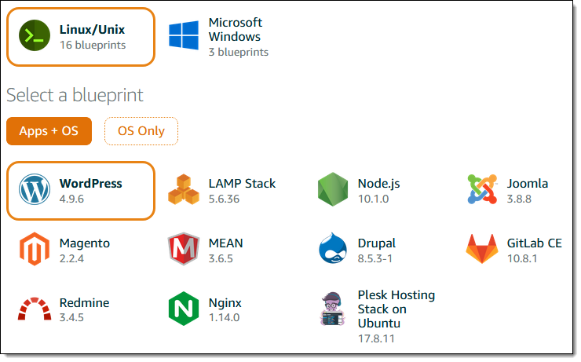
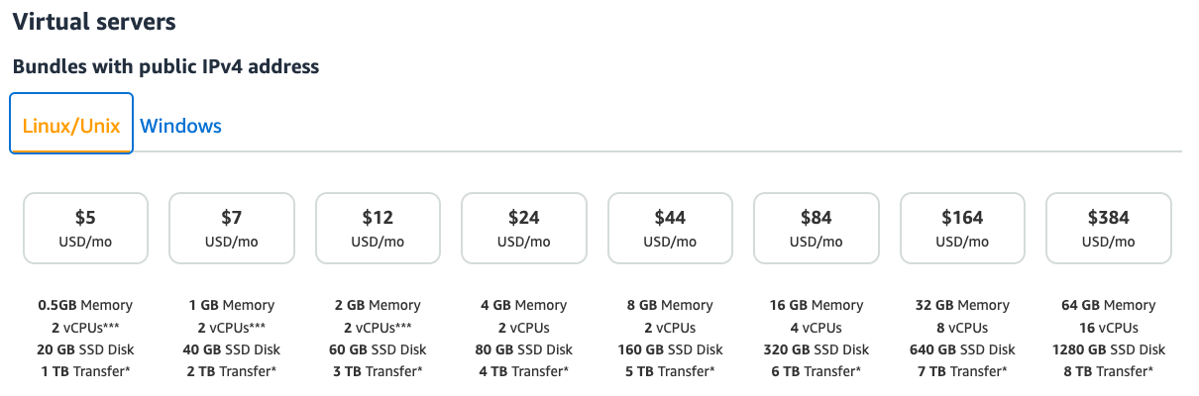

Lightsail
✓ Simple Pricing
✓ Small Shops
✓ AWS VPS
✓ Migrate to AWS

Slide 30
Data Services Savings

Slide 31
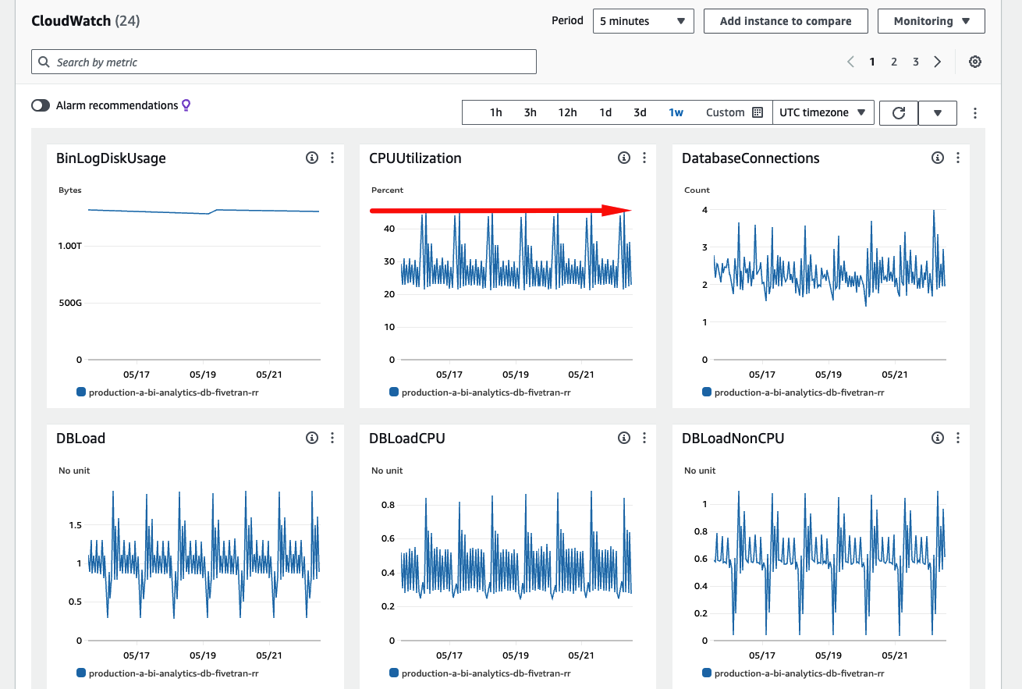
RDS Observability Metrics
CPU/Memory
IOPS
Throughput
EBS Balance (byte/%)

Slide 32
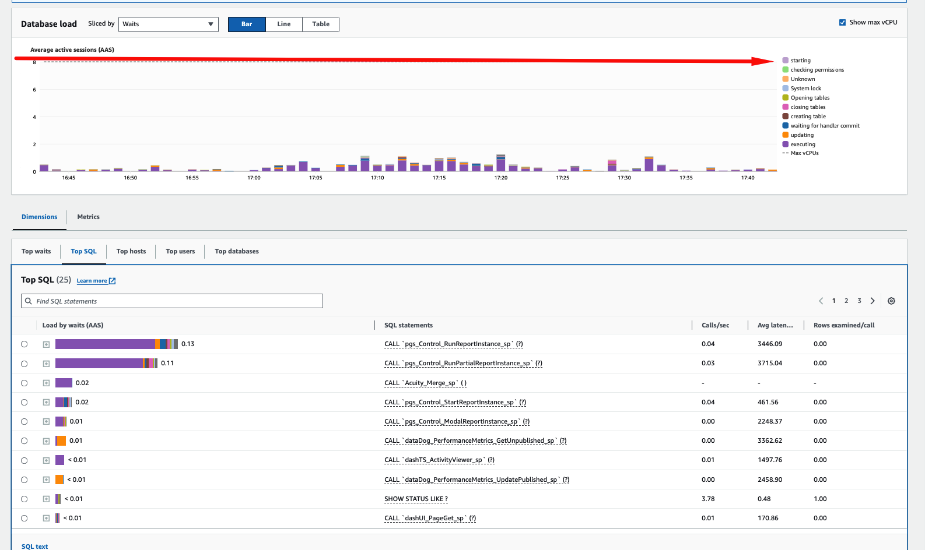
RDS Query Optimization
Optimize Queries
Identify Bottlenecks

Slide 33
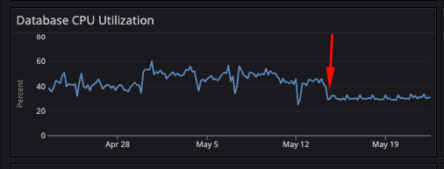
RDS Instance Updates
Try Graviton3 because it’s less expensive than AMD/Intel
Move to the latest generation for faster performance and reduced costs

Slide 34
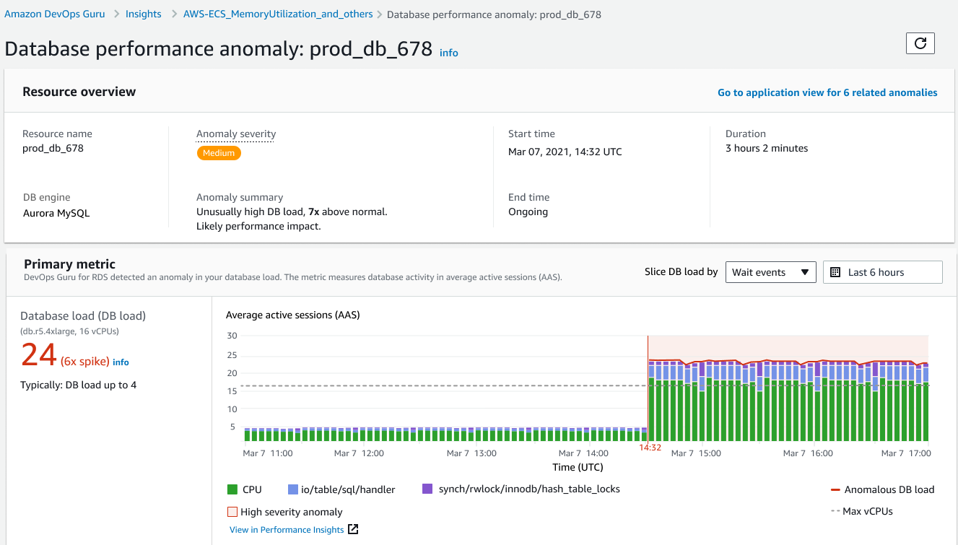
DevOps Guru for RDS
Detect and diagnose RDS database performance bottlenecks and operational issues

Slide 36
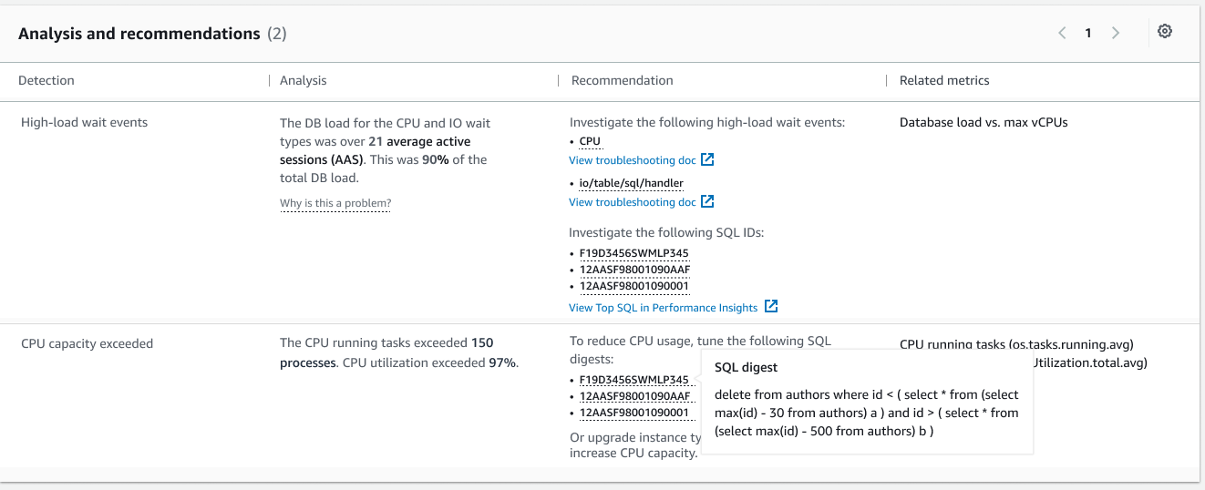

Slide 37
Stop Running MSSQL!
=
Instances are ~3x more than PostgreSQL

Slide 38
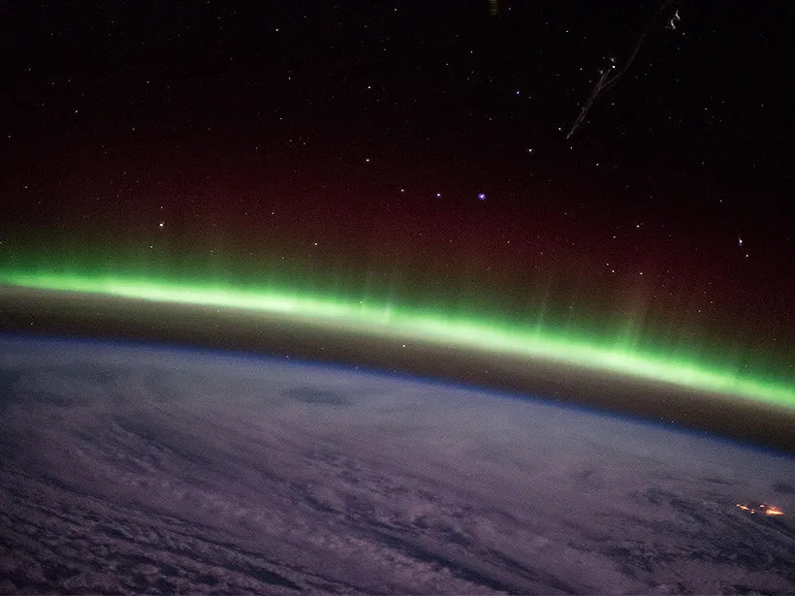

Aurora
Increased Throughput
5x of MySQL
3x of PostgreSQL
More Read Replicas (up to 15)
Clone without increasing Storage Costs
Backtrack (MySQL)
Babelfish Extension (PostgreSQL)
Migrate from Microsoft SQL Server (MSSQL)

Slide 39
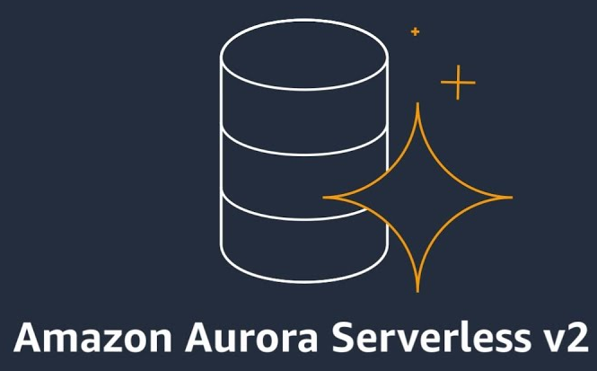
Aurora Serverless
v2 and v1 (deprecated)
Requires a VPC, Subnet Group, and Security Groups
Automatically Scale Up and Down
Does NOT Scale to Zero
Good for Non Prod

Slide 40

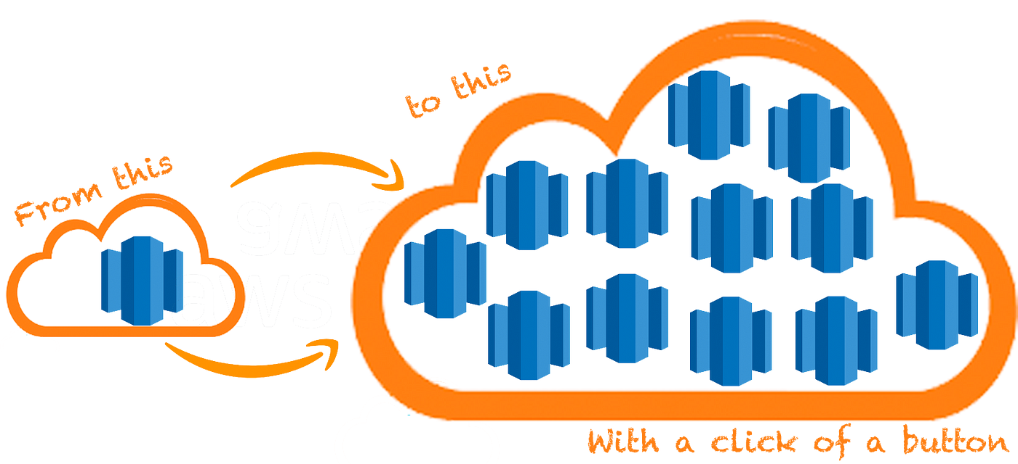
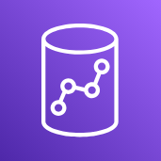
Redshift
Compression
Concurrency Scaling
Distribution Style

Slide 41
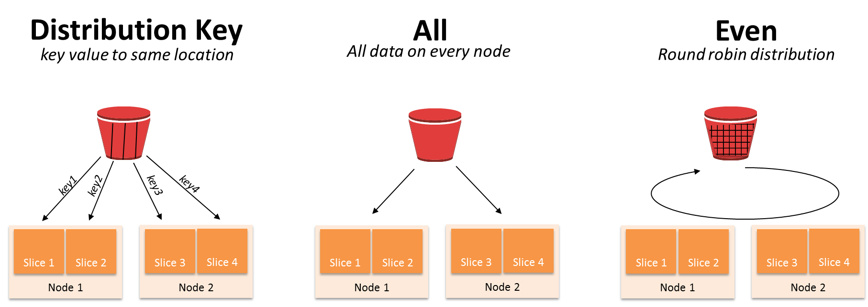
Redshift Distribution Styles

Slide 42
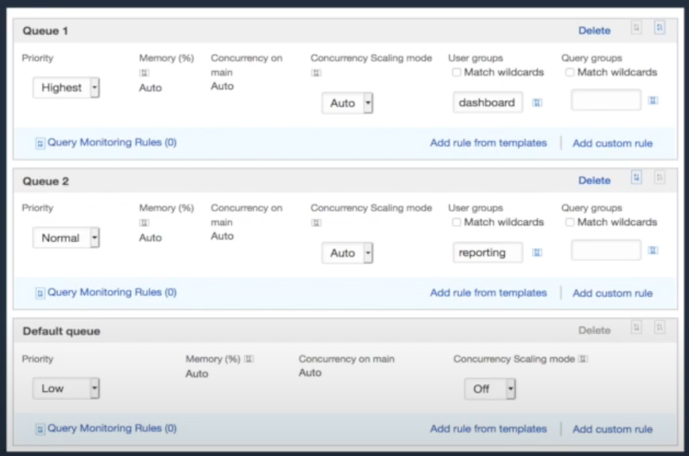

Redshift
Compression
Concurrency Scaling
Distribution Style
Pause
Vacuum
Workload Management (WLM)

Slide 43
Redshift Workload Management (WLM)

Slide 44
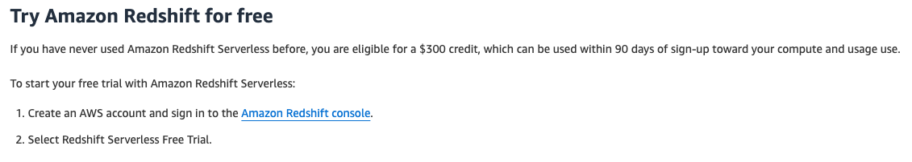

Redshift Serverless
Automatically Scale Up and Down
Does Scale to Zero
Good for Non Prod

Slide 45
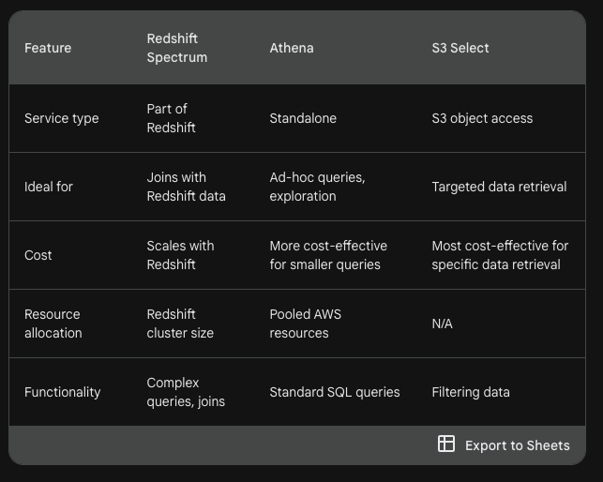
Standard SQL for S3
Redshift Spectrum
Athena
S3 Select

Slide 46
Standard SQL for S3

Slide 47
Network Savings

Slide 48
Networking Considerations
Use AWS Services
(TGW, WAF, etc.)
Do NOT Deploy Too Many AZs
IPSEC VPN is Usually Sufficient
Component Placement and Traffic Fees

Slide 49

Network Endpoints
Deploy only what you need (resolver, SSLVPN, TGW, etc.)
Use VPC Endpoints for AWS services

Slide 50

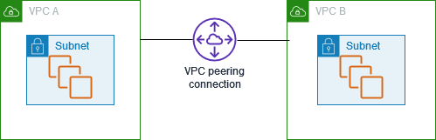
VPC Savings
Delete Unused NAT Gateways
Delete Unused IP Assignments
Consider VPC Peering for Small Deployments
2-5 VPCs (free inter-VPC traffic)

Slide 51
Backups, Logging and S3

Slide 52
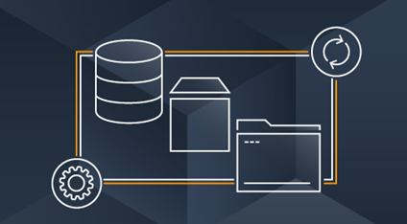
Backups
Monitor, alert, and notify backup metrics
Certain kinds of workloads cost a lot to backup (high deltas)
Don’t keep backups longer than you need
Only backup what you need (data, not cattle)

Slide 53


Logging
Don’t Log Everything! (unless you need to)
Don’t Store Logs Twice!
Control Tower can ship logs to an observability platform
Archive Required Logs with S3
CloudWatch Lifecycle Policies
CloudWatch Ingest is High ($0.50 per GB)

Slide 54
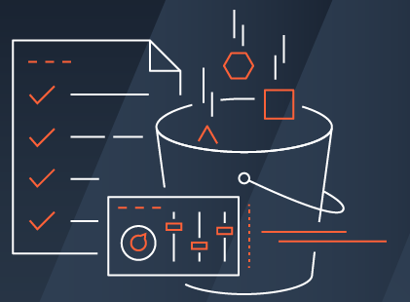
S3
Monitor, alert, and notify on S3 bucket size
Storage Classes
Be careful with Intelligent Tiering!

Slide 55
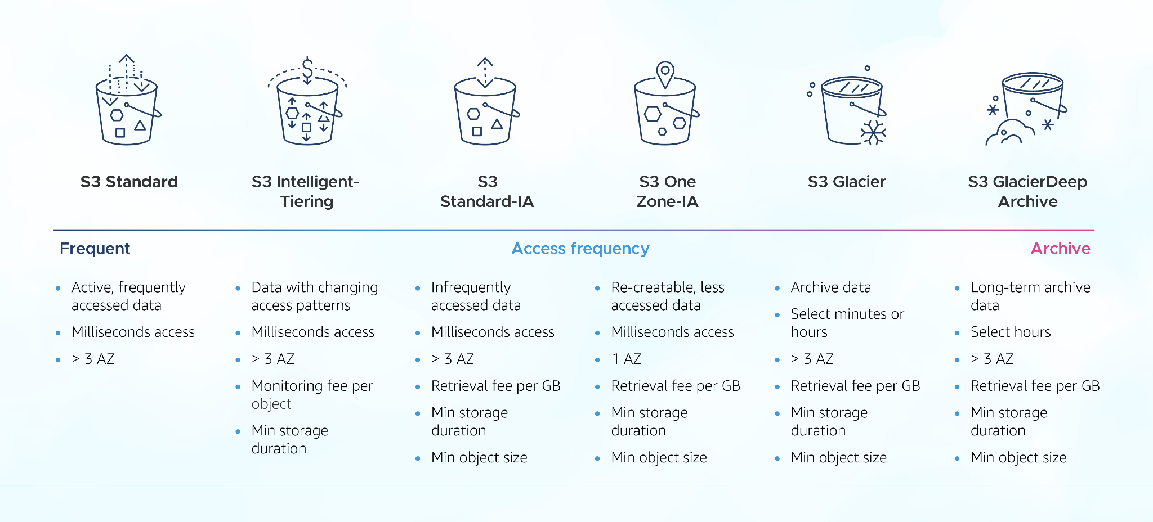

Slide 56
S3
Monitor, alert, and notify on S3 bucket size
Storage Classes
Age/Tier appropriately
Glacier data retention fees
Consider transfer fees

Slide 57
Tools

Slide 58
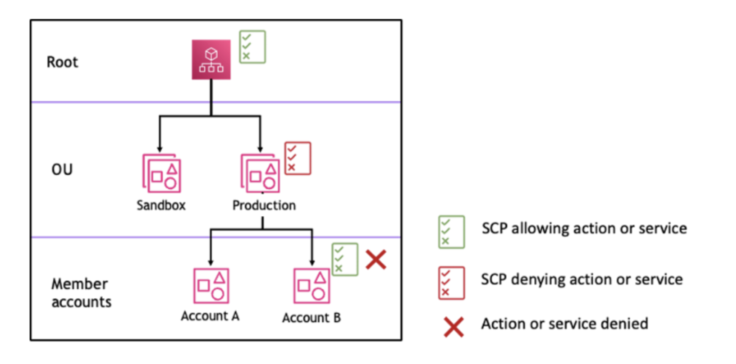
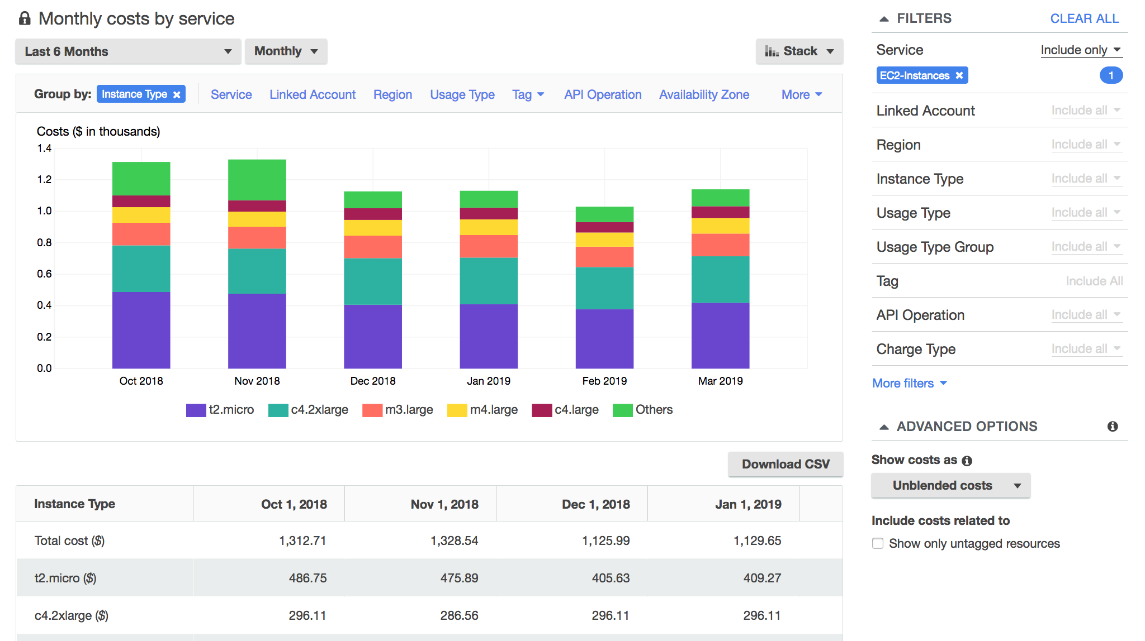
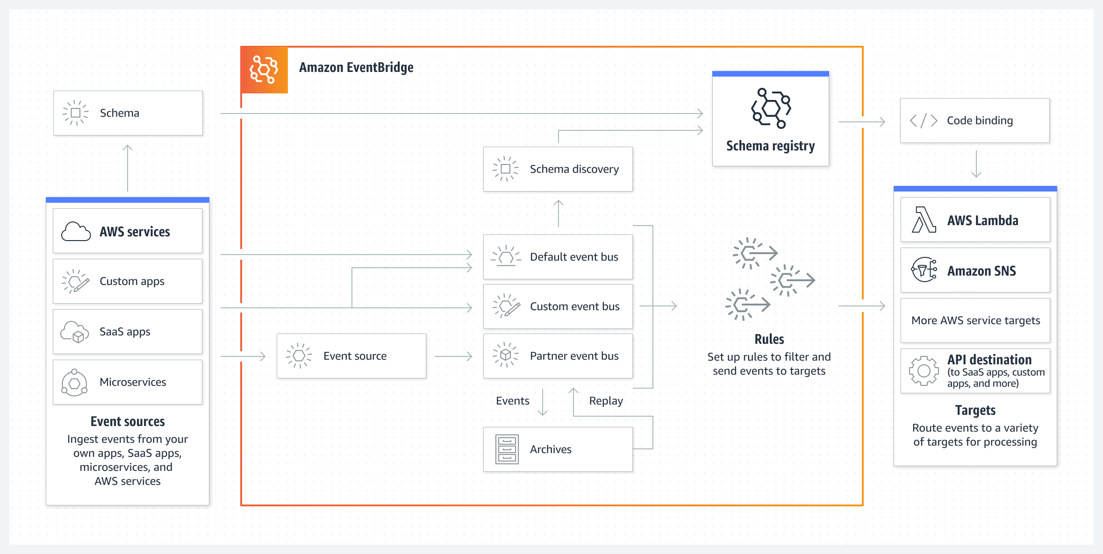
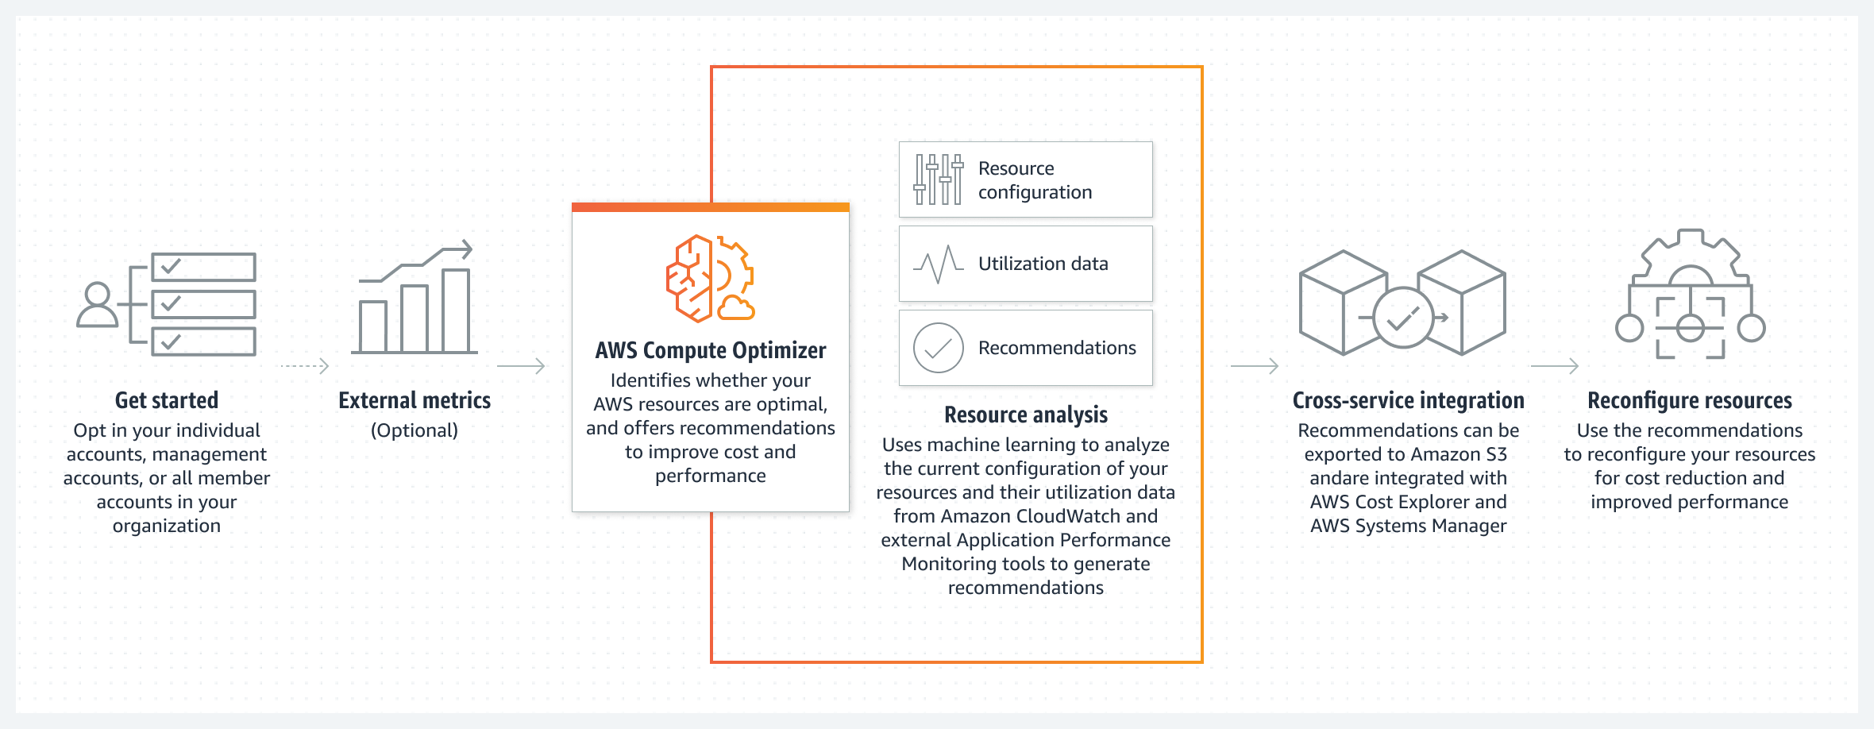
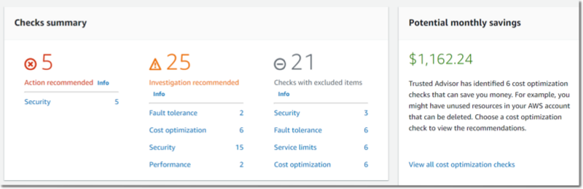
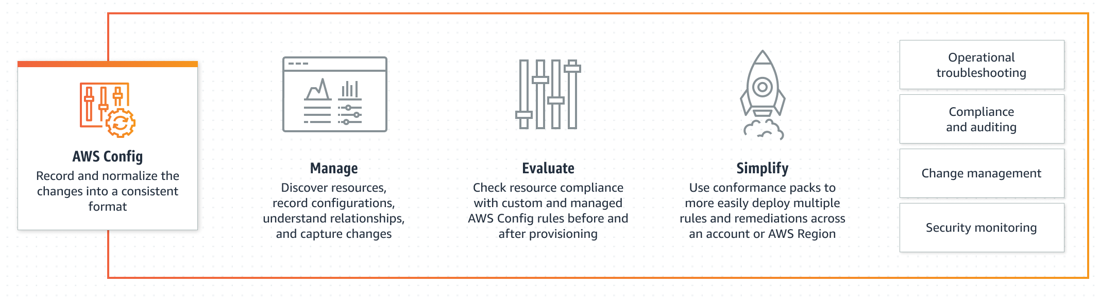
AWS Tools
Compute Optimizer: right-sizing tool
Config: detect and alert (expensive)
Cost Explorer: view and filter by tag
EventBridge: scale up and down
Service Control Policies (SCPs): restrict expensive instances
Trusted Advisor: glean information related to cost

Slide 59
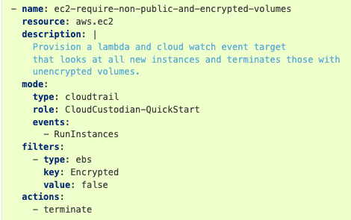

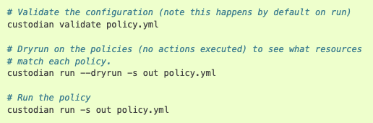
3rd Party Tools
Cloud Custodian: simplified automated tasks
IAC Linting: prevention of expensive resources
CI Checks: build in cost validation, auto comments

Slide 60
Purchasing Options
More Ways to Pay

Slide 61
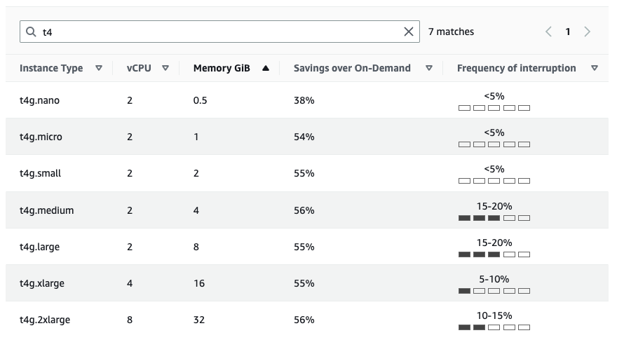
Spot Instances
Spare Capacity
Significant Savings
Can be Terminated
Good for Non Prod
Available for Multiple Services (ECS, EKS, etc.)
https://aws.amazon.com/ec2/spot/instance-advisor/

Slide 62
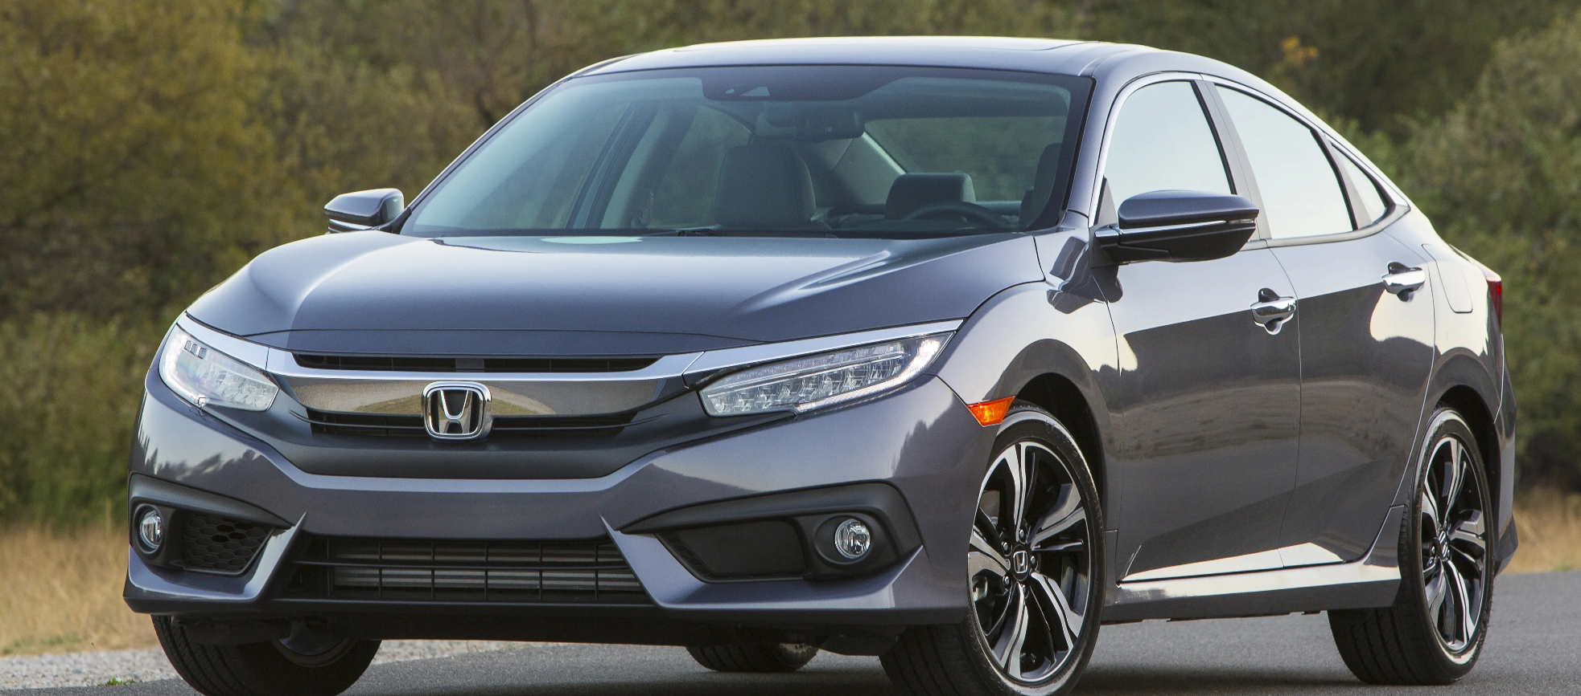

Reserved Instances
Standard
Convertible
1yr (40%), 3yr (60%)
Avg Discount
1yr (31%), 3yr (54%)
No
Can Exchange?
Yes
Yes
Can Sell?
No

Slide 63
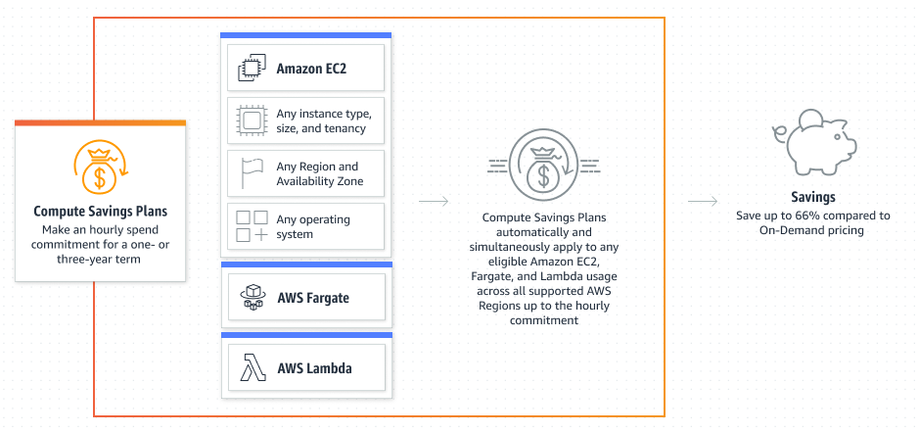
Compute Savings Plans

Slide 64
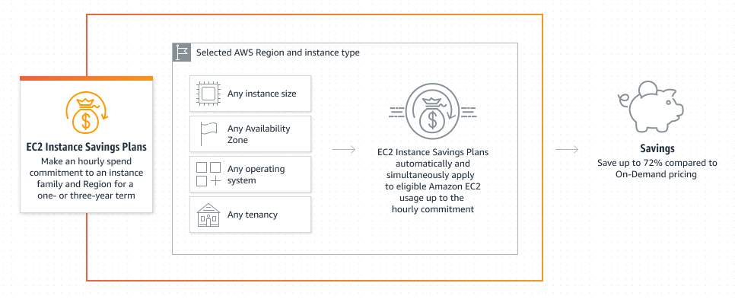
EC2 Instance Savings Plans

Slide 65
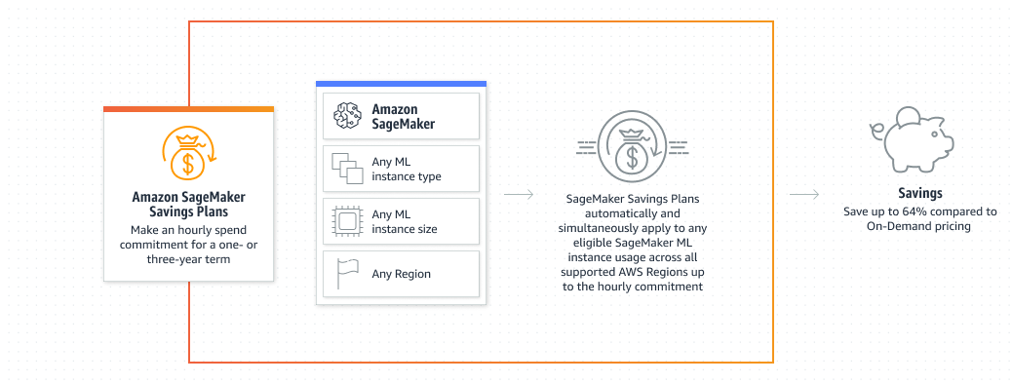
SageMaker Savings Plans

Slide 66



Slide 67
Plan Realistically

Slide 68
Audit Timing
Normally a quarterly process
Plan for team commitments to the audit
Migration efforts may continue after the audit
Audits will take less time if done regularly
Establish written policy and procedure

Slide 69
It starts and sticks with accountability

Slide 70
Accountability
Architectural Decision Records
Who decided what?
Link approval to real $ numbers
Who approved this?
Link real $ numbers to actual work
Who implemented this?
Use an Accountability Framework
RACI, DACI, etc.
Assign Ownership Responsibility
Auditing Policy and Schedule
Regular Cleanup
“Accountability breeds response-ability.” -Stephen Covey

Slide 71


Slide 72


Discord
Come hang out!

